Slide 1
Ohio leads the way –
Certification Rules 2025
A brief overview on the challenges facing Ohio’s building code enforcement community, and the plan to recruit new personnel for the 21st century.
Notes:
Hello, and welcome to the Board of Building Standards presentation on our new certification rules which will become effective July 1, 2025.
My name is Megan Foley, and I am the Professional Development Coordinator for the Ohio Board of Building Standards.
Along with my excellent team. I am responsible for the certification and education of building department certified personnel and certified building departments.

Slide 2
Presentation Overview
A brief history of Ohio’s certification rules current state – Meg Foley
The Human Experience – Amy Jones, Certification Specialist
The problem
The plan
How the new certification levels work
Building department adaptation
Notes:
Today we will be discussing [read slide]

Slide 3
Old Certification Rules – ICC Study 2023
Highly specialized
Little mobility within code enforcement career
Much higher experience requirements compared to other states and jurisdictions.

Slide 4
The Human Experience
Specific experience requirements for each certification means that people are siloed into original qualifications
Retiring personnel hold an average of 5-8 certifications
New certified personnel hold on average 2-3 certifications
Notes:
Our number of applicants each year have been rising, but that alone does not solve the problems created with the long-term code enforcement personnel retiring.

Slide 5
The human experience
Departments already facing personnel shortages.
Personnel retiring for the second, third or fourth time, sped by Covid.
Notes:
Conditions like the building boom Ohio is experiencing, the missing generations in the construction trades, and Covid have all exacerbated the shortage of certified personnel. Many of our certified people work for 2, 3 or more building departments.

Slide 6
History of Development
March 2022 Public Meeting
ICC Certification Study
A new idea
Rules filed October 2024
Notes:
Before we began this process ,we were hearing from building departments across the state that they could not find people, vacancies were impossible to fill, and people were retiring faster than they could be replaced. As a result, BBS convened a public meeting in March 2022

Slide 7
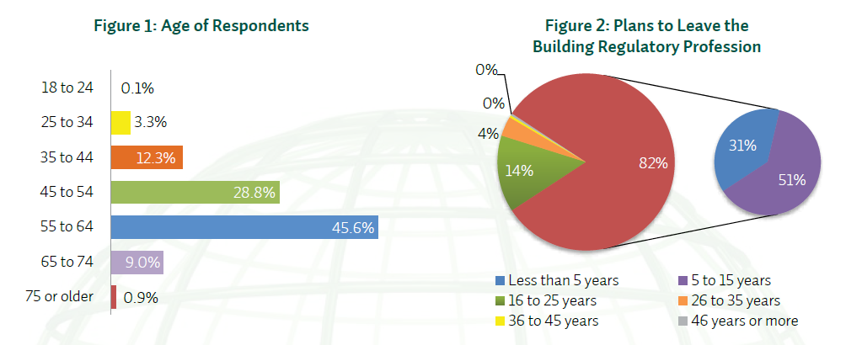
The problem
2014 ICC Study: The Future of Code Officials ©
Predicting retirement of 82% of all present Code Officials by 2029
Notes:
On my first day at BBS, Steve Regoli presented me with this existential problem. He told me that by 2024, 50% of BBS’s certified personnel would be retired. In fact, the problem was even more dire, as you can see in these graphs.

Slide 8
The plan
Provide a career path from Permit Tech to Building Official
Making code official careers accessible to more people
Encourage cross-training within departments
Allows departments to build from within
Provide new pathways to certification
Brings new talent into the code profession
Honor traditional certification paths
Notes:
We knew we needed to do something different.

Slide 9
How the new certification levels work
Level 1 – Administrative
Level 2 – Residential Code Official
Level 3 – Commercial Limited Inspector
Level 3 -- Commercial Limited Plans Examiner
Level 4 -- Combination Inspector
Level 4 -- Combination Plans Examiner
Level 5 -- Commercial Building Official
Level 6 -- Comprehensive Code Official

Slide 10
How the new certification levels work: Endorsements
Building
Electrical Safety
Energy Conservation
Fire Protection
Mechanical
Plumbing
Residential Electrical
Residential Plumbing
Building
Electrical Safety
Energy Conservation
Fire Protection
Mechanical
Plumbing
Plans Examiners
Inspectors
Obtain endorsements through training and testing

Slide 11
New certification rules Key Features
Cross train
*Build competencies in areas other than your initial certification
Maintain fewer certifications
*Level 3 and above can perform residential code work
*Hold at most 3 certifications
*Endorsements can be used like additional certifications are now, and are free.
Three years for initial certification – additional time for tests and code academy
Enter at level you qualify for, build from there

Slide 12
Building department cross-training Cycle
Training another person for endorsement
Training for new endorsement
Working with new endorsement

Slide 13
Questions for Discussion
What do you hope the results of the rule change will be?
What challenges or pitfalls do you imagine or foresee?
What benefit do you see from continuing to require experience or training for certification in Ohio?
Audience Q & A

Slide 14
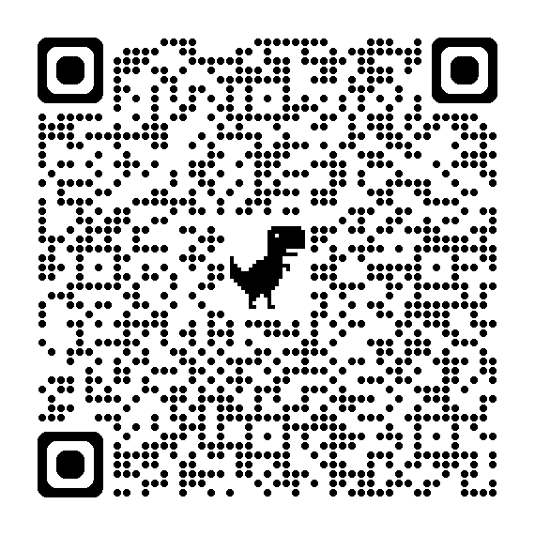
New Certification Rules On the BBS site
Certification Rules

Slide 15
Amy Jones
Certification Specialist
Board of Building Standards
614.644.3777
amy.jones@com.ohio.gov
Meg Foley
Professional Development Coordinator
Board of Building Standards
614.644.3779
mfoley@com.ohio.gov

