Slide 2
Ann Russo, Executive Director
Building Officials Association of Florida

Slide 3
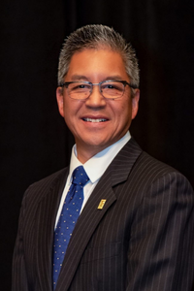
Opening Remarks
Stuart Tom, President
ICC Board of Directors
Dominic Sims, CEO
International Code Council

Slide 4
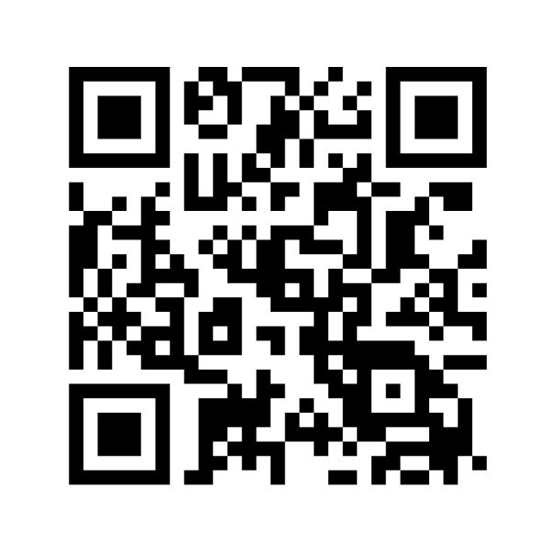
Travel Reimbursement Form

Slide 5
Thank you for attending the 2024 Chapter Leadership Academy. We hope your Chapter will join us again next year!
Please scan the QR code and fill out the Academy evaluation. This will help us to provide programs and resources to help your Chapter better serve and support your members.

