Slide 1
Chapter Advocacy
2025 Chapter Leadership Academy
Gabe Maser
Senior Vice President, Government Relations
April 26, 2025

Slide 2
Why Should I Be a Code Advocacy Leader?
As a code professional, you are an integral part of your community because you affect the way the built environment is constructed, which protects lives and enables community growth
It’s critical that you and your colleagues keep tabs on policy developments concerning building safety officials and create avenues to tell your stories to elected officials, other policymakers, and the general public so that they appreciate your hard work/the importance of building safety, and write policy that furthers your efforts
Notes:
We updated this because we want to be sure you have the tools to advocate for your self, your chapter, and your profession
No one likes having things happen to them. Unfortunately, we’re increasingly seeing that in our profession.
Housing affordability – building departments and code are scape goats. What are they doing – taking away local authority over permitting; giving shot clocks;
In the codes space, they’re legislating code – expanding the scope of what’s IRC construction; changes to life safety provisions. Limits on inspection types etc.
You may have an opinion on those things. Shoot I hope you do! The good news is that it’s actually not all that big a lift to make your voice heard.
Your experience matters

Slide 3
So Where Do I Begin?
Know Who Makes Decisions That Impact You and Your Community
Do you know who are your U.S. Senators?
Do you know who is your member of Congress?
Do you know who is your Governor?
Do you know who is your State Senator/Representative?
Do you know who is your Mayor/City Councilor/County Commissioner?

Slide 4
So Where Do I Begin?
Be Aware, Get Engaged
Does your ICC chapter have a legislative/policy committee?
  Who is involved in a chapter legislative committee? What works?
How do I start a legislative committee?
  Find a few people interested in the legislative process
  Partner with another group with similar interests – for instance: architects, engineers, fire marshals, municipal leagues, etc.
  Determine areas of focus/priorities (funding, shot clocks, code rollbacks/delays, enforcement officer safety, recognition of your department’s value)
  What priorities have your chapters identified?
Reach out to your ICC-GR rep for advice and assistance!
Notes:
You all work in government; you know your mayors city council members; many of you I bet know folks beyond that
You’ve got a ready-made network; now you’re going to layer in more chapter colleagues, and the web expands.
Do that through a legislative or policy committee; you’ve got plenty on your plates as it is; leverage the energy of the folks interested in this stuff to form a committee
Partner with some other organizations – and it gets even bigger

Slide 5
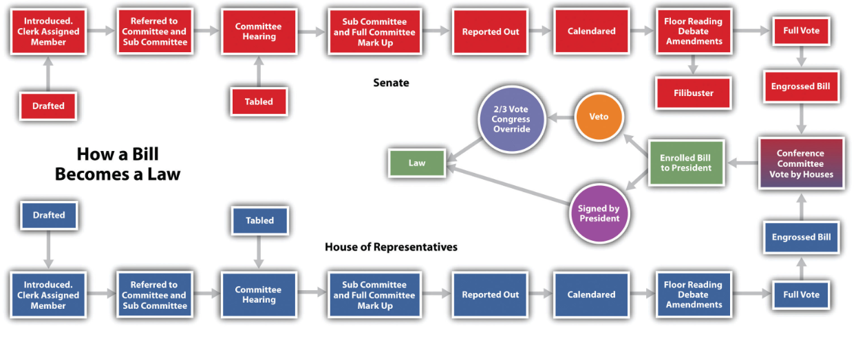
Congressional Legislative Entry Points
Notes:
Note different states have different processes

Slide 6
Example Regulatory Entry Points
Statute authorized rule
OMB/state analog review
Proposed rule published
Hearings/ public comment
Comments considered
OMB/state analog review
Final rule published
Judicial/ leg review
Idea
Notes:
Note that this one example; individual AHJ processes may differ

Slide 7
Telling Your Story
If People Don’t Know, They Can’t Care
GOAL: Talk positively about how your department is protecting and contributing to the community and, based on that foundation, support your policy goals
Why?
The people who show up are the ones that get results.
Public officials are people like you, so don’t be intimidated to tell your story.
Don’t be shy! Telling your story is as easy as telling someone you had a good day at work because you saw a new, safe home being built down the street.
Notes:
This is about not being intimidated
Lawmakers make decisions on data; they want to hear from stakeholders with expertise

Slide 8
Communication Tools You Can Use
Writing a Letter/Email
GOAL: Focused arguments written clearly, usually just a few paragraphs.
Answer the Who? Where? When? Why? and What?
Email is preferable because hard copy letters are often delayed

Slide 9
Communication Tools You Can Use
Visiting a Policymaker
GOAL: Personal visits resonate with decision makers who now have a face and hometown story to put with an issue. Note: staff can be just as important as electeds.
Who has participated in a chapter’s legislative/capitol event?
  What worked? How did the day go? How did the meetings go?
Notes:
Prep in advance – talking points, their bio, stats

Slide 10
Communication Tools You Can Use
Hosting an Event
GOAL: Create an opportunity for policymakers and the public to learn more about the importance of your work and modern codes.
Who has hosted an event?
  What worked? How did the day go? What was the benefit of the event?
  Building Safety Month as well as ABMs provide ready-made opportunities to build an event for area policymakers that highlights your department/chapter’s efforts

Slide 11
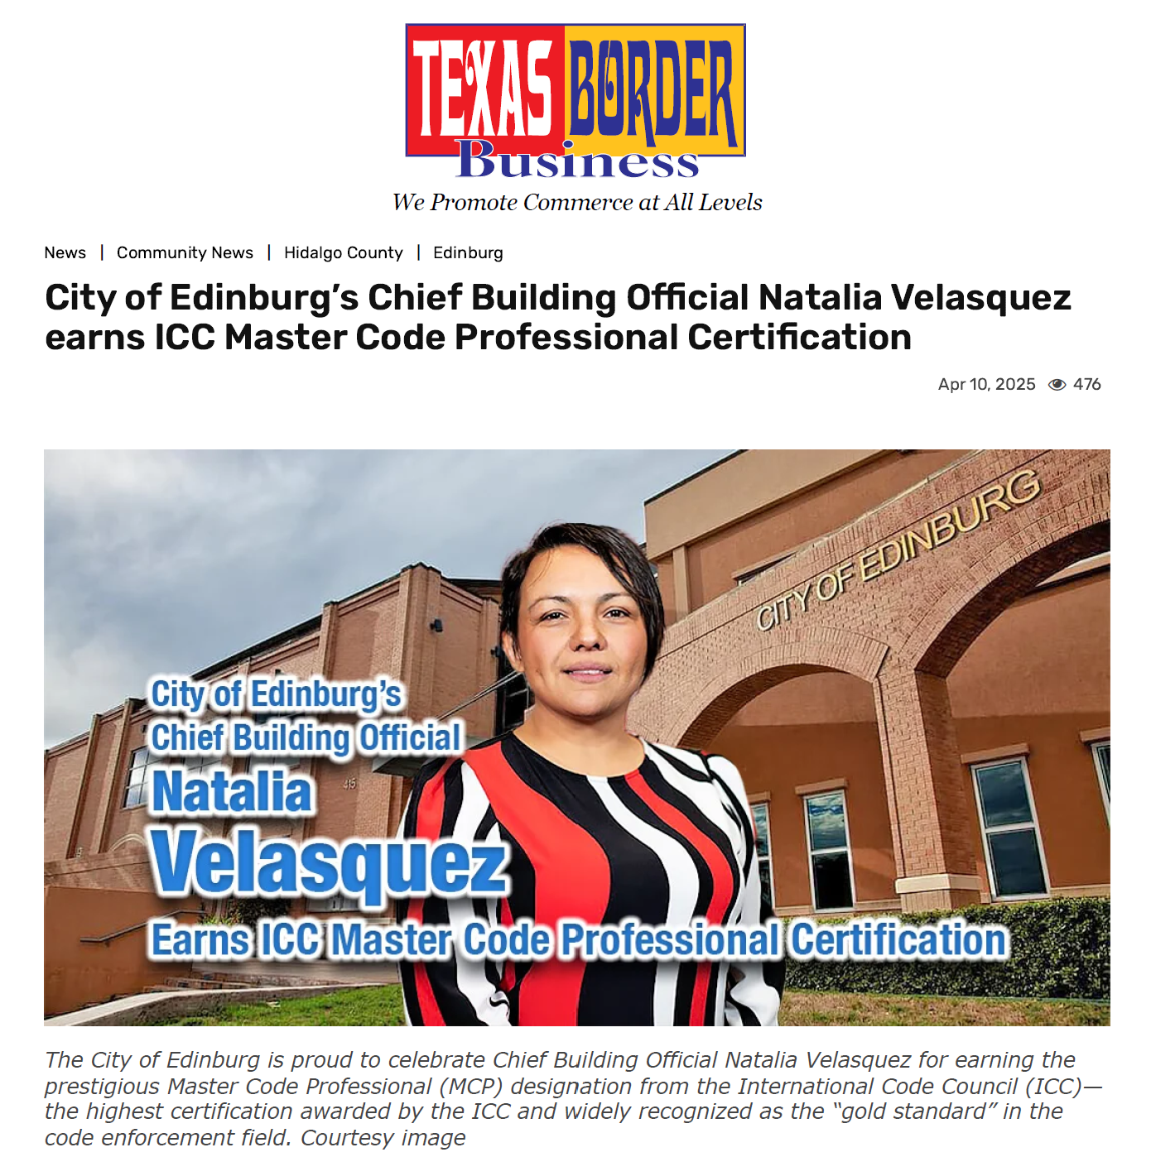
Communication Tools You Can Use
Public Relations
GOAL: Create an opportunity for policymakers and the public to learn more about the importance of your work and modern codes.
Who has implemented a public relations effort?
  What’s worked for you? What benefits did you see?
  Example PR: social media, press releases
Notes:
Note small wins – permitting outcomes, new projects, certifications

Slide 12
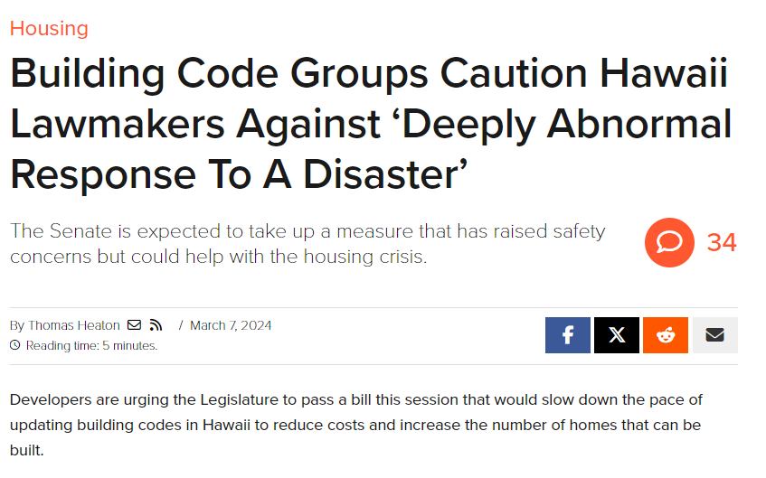
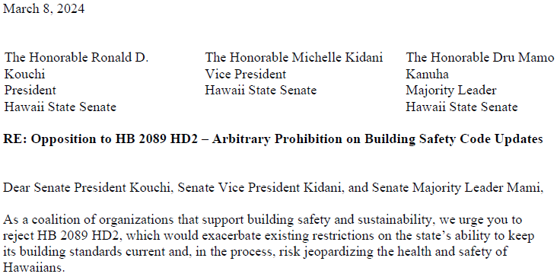
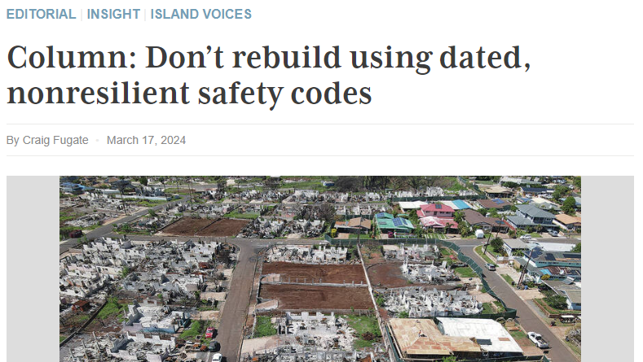
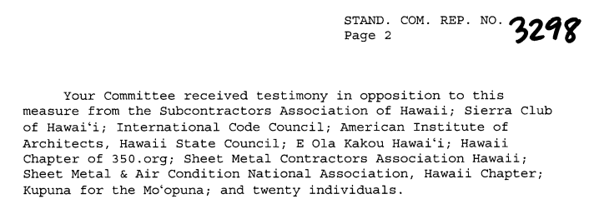
ICC-GR Advocacy in Action

Slide 13
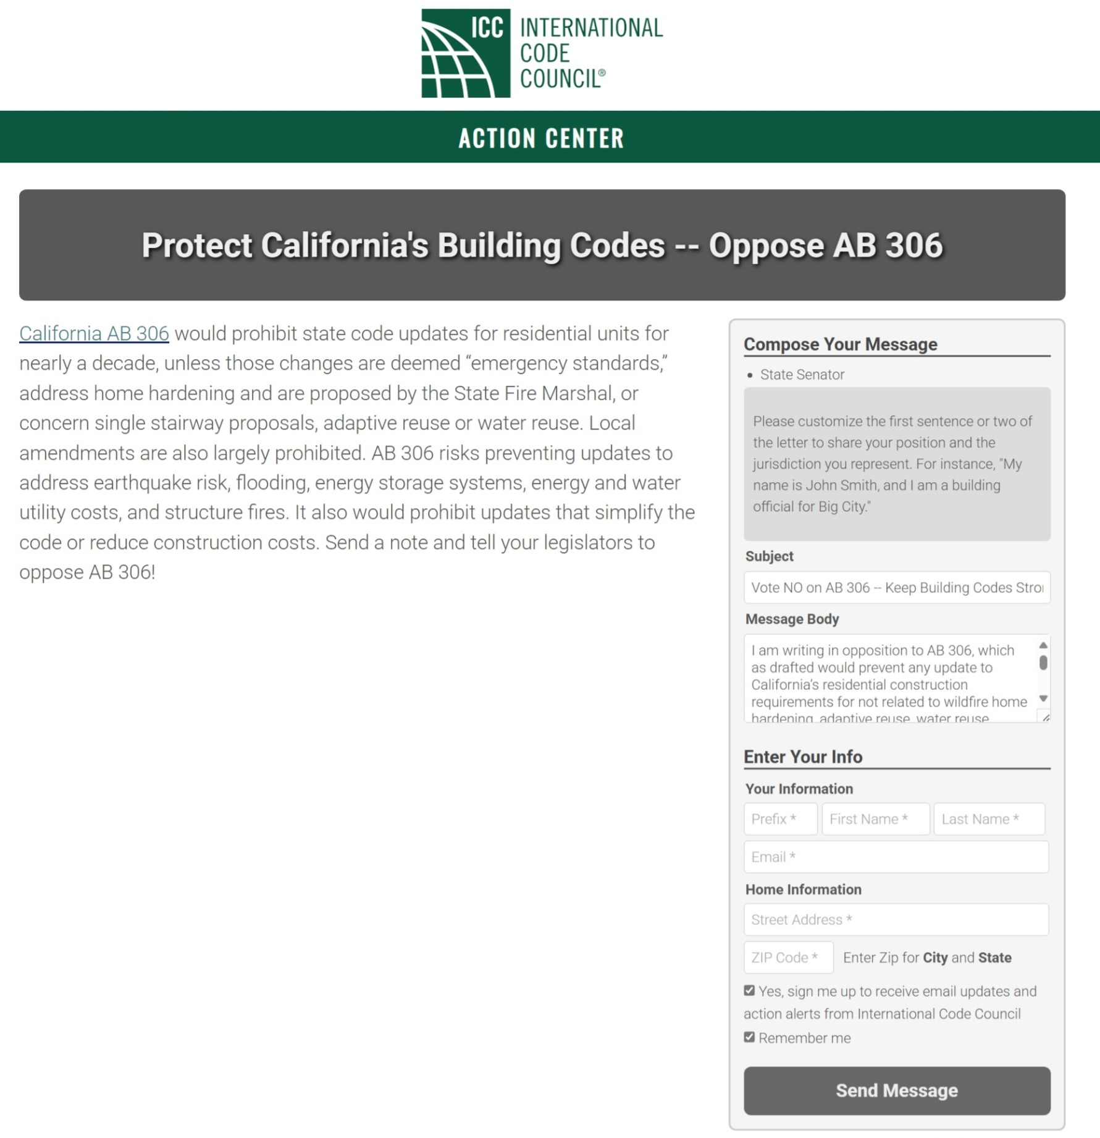

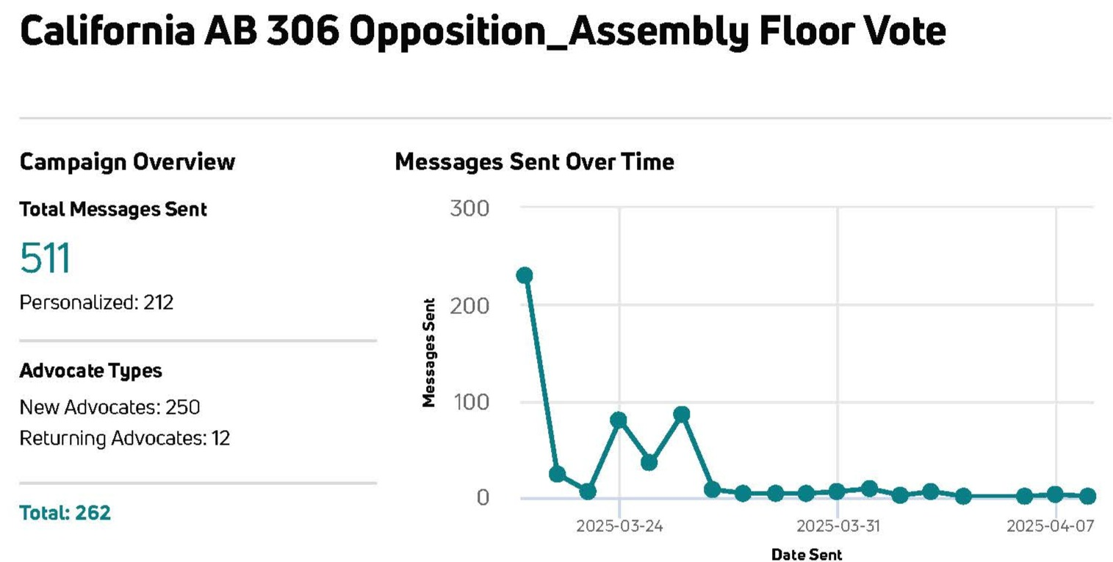
ICC-GR Advocacy in Action

Slide 14
Put ICC’s Government Relations Team to Work for You!
With backgrounds in elected office, state and local administrations, media, political consulting, and grassroots organizing, the ICC Government Relations staff can assist, answer questions, and serve as a sounding board to support your chapter’s legislative and regulatory engagement.
Visit the Government Relations webpage at www.iccsafe.org/advocacy to find the contact information for your local liaison.

Slide 15

State and Local Areas of Responsibility

Slide 16
