Slide 1
Supporting Safety Codes
The Importance of Passing the Pro Codes Act (H.R. 4072)

Slide 2
Your Efforts Produce World-Class Codes
America's codes and standards, which are vital to public health and safety, are developed by and for building safety professionals.
Top-quality codes stem from your hard work and commitment, which is why ICC re-invests revenue from codes sales into the code development process and the future of our industry.
Notes:
Rigorous national codes and standards are developed by non-profit standards development organizations (SDOs) through a consensus-based process at no cost to taxpayers. The current standards development system has been effective and efficient for 125 years. Officials at the federal, state, local, and municipal levels depend on the expertise of these SDOs by often incorporating codes and standards into the laws they enact. The result has saved lives, fostered economic growth, and generated billions of dollars in taxpayer savings.

Slide 3
Defend Your Work
Companies that contribute nothing to code development have decided that it’s easier to take and sell your work than it is to develop or pay for it themselves.
Pro Codes Act:
Bi-partisan: Representatives Darrell Issa (R-CA) and Deborah Ross (D-NC);
Protects the code development process;
Prevents unauthorized/incorrect copies of the code from being published; and
Ensures Standard Development Organizations and their members can continue to invest in building safety professionals and future code development
Notes:
The passage of the bipartisan Pro Codes Act will ensure the continued production of high-quality standards and codes that are integral to the functioning of American society.
H.R. 4072 clarifies that a standard does not lose its copyright protection by being referred to in a law or regulation, provided that the standard is available for free viewing on a publicly accessible website. This solution will enable the American people to access codes and standards that affect their daily lives at no cost, while preserving the efficient and effective public-private standards development system.

Slide 4
Broad Coalition of Supporters

Slide 5
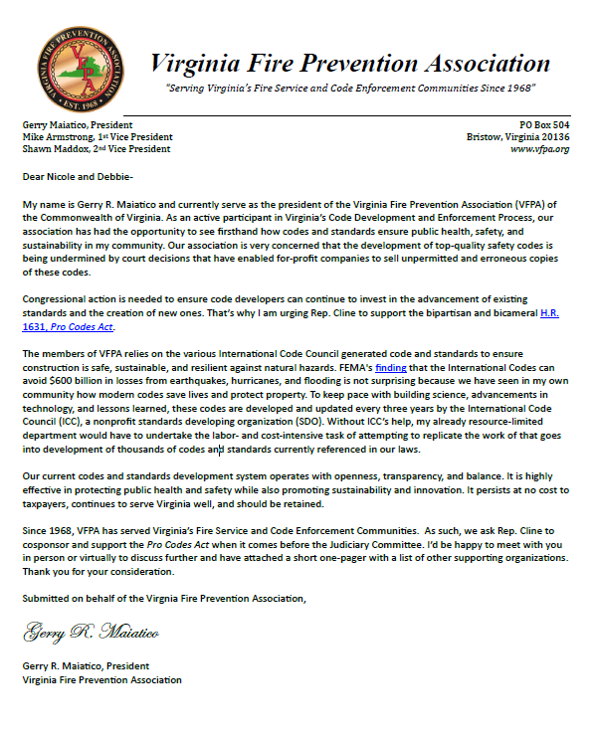
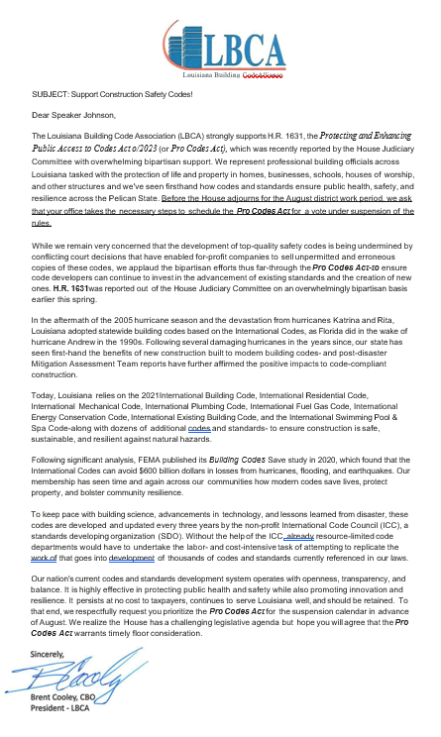
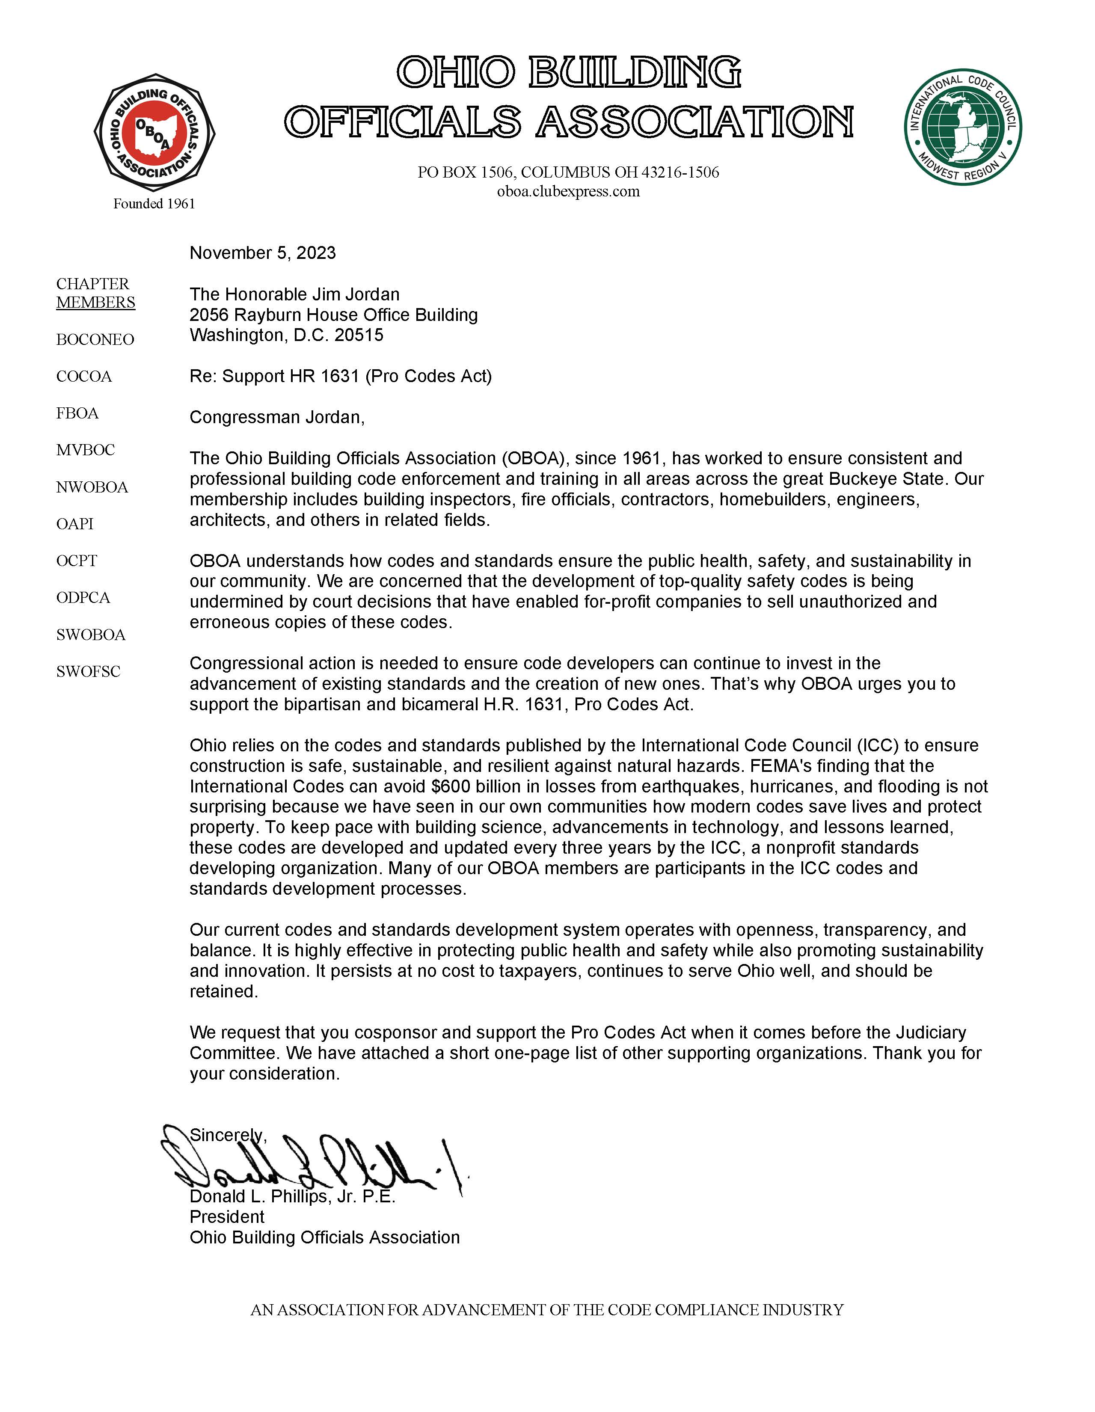
Next Steps – How You Can Help
Send a letter of support from your local or state chapter to your Member of Congress in support of the Pro Codes Act.

Slide 6
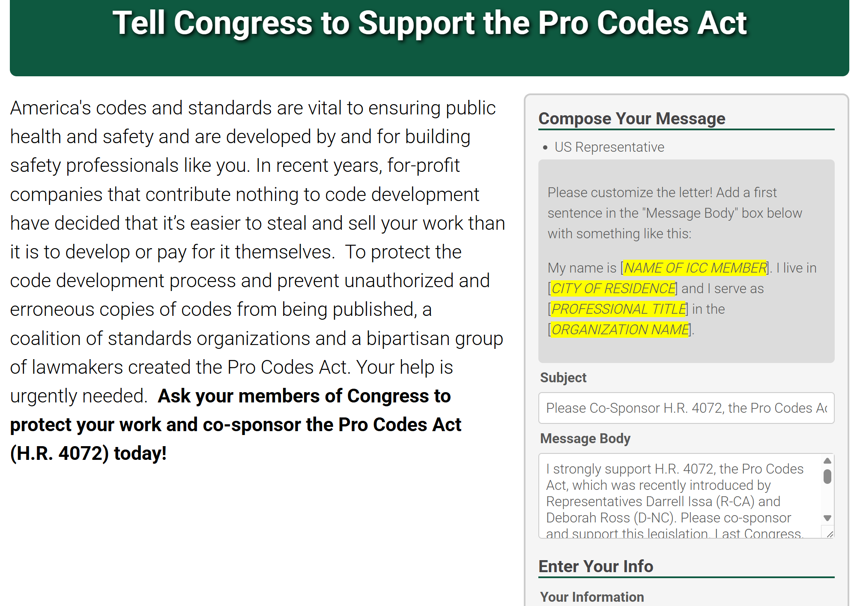
Next Steps – How You Can Help
In less than 5 minutes, customize and send a pre-drafted letter of support.
Encourage your chapter members to do the same!

Slide 7
Thank You – Questions?
Gabe Maser, Senior Vice President, Government Relations (gmaser@iccsafe.org)
Aaron Levy, Vice President, Federal Relations (alevy@iccsafe.org)
Lesley Garland, Vice President, State and Local Relations (sgarland@iccsafe.org)
Lisa Berger, Government Relations Manager, (lberger@iccsafe.org)

