Slide 1
The Minimum Standard
ICC APPEAL HEARINGS | August 26, 2020
Stairbuilders and Manufacturers Association, www.stairways.org
David W. Cooper, Code Development Representative
Coderep@stairways.org

Slide 2
Introduction
The Stairbuilders and Manufacturers Association, SMA has been the active voice of the stair industry and since its inception in 1988 has participated in Code Development.
David Cooper has been a Stairbuilder since 1973 and since 2001 has served as the SMA Code Development Representative.

Slide 3
The Minimum Standard
By definition the ICC codes are a minimum standard of safety.
The SMA supports the 7¾” x 10” minimum standard for riser height x tread depth to replace the long accepted 8¼” x 9” standard .
This was established by compromise many years ago due to lack of empirical evidence that would support anything more restrictive.
Since that time additional studies have proven the efficacy of 7¾” x 10” as a minimum standard of safety for certain residential stairways.

Slide 4
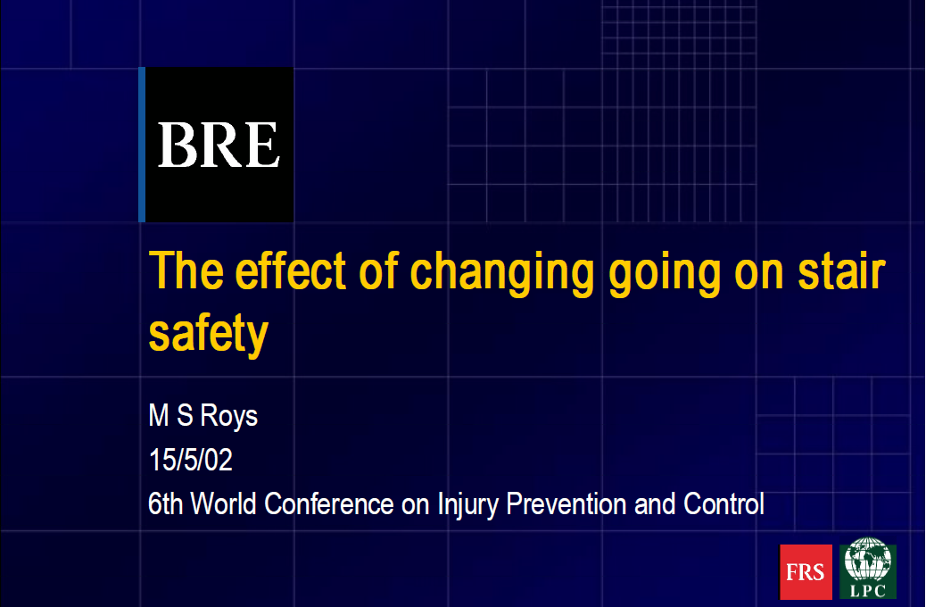
Due to time constraints I must limit my reference to relevant portions of two of the studies the appellant has cited.
The first looked at the effect of changing the tread depth, “going” as it called in the UK, while maintaining a constant riser height.

Slide 5
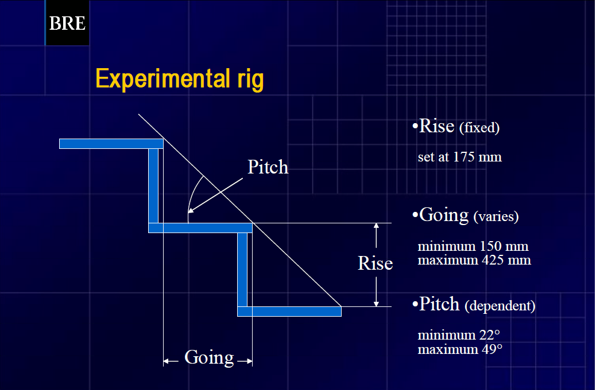
Note the riser height is fixed at 175 mm or 6⅞ inches.
The tread depth varies from;
150 -425 mm or 5¹⁵/₁₆ - 16¾ inches
Stairs are much steeper in the UK

Slide 6
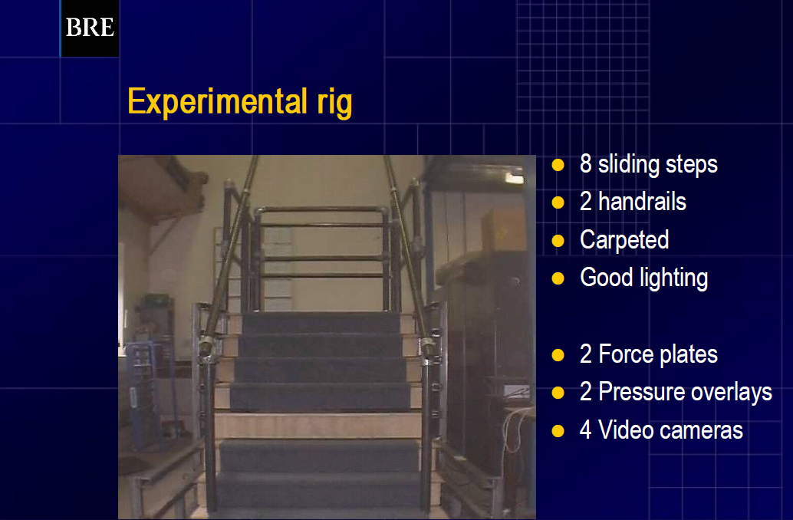
The test fixture allowed adjustment of the tread depth and measurement of foot position.
Video cameras allowed objective observation.

Slide 7
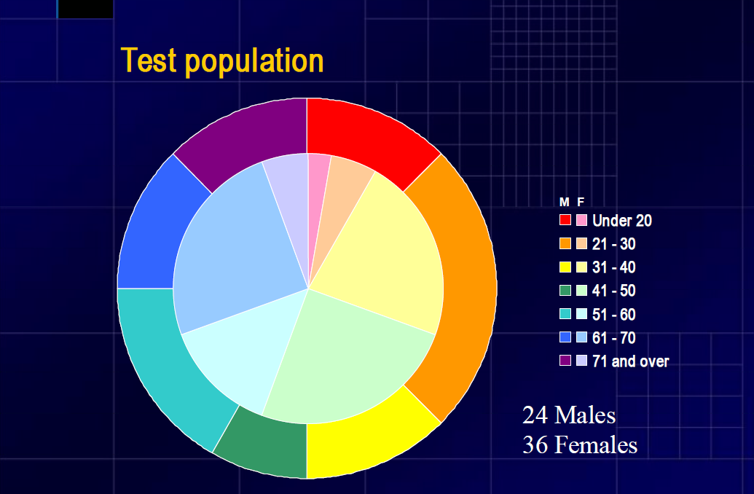
A representative population of 60 subjects

Slide 8
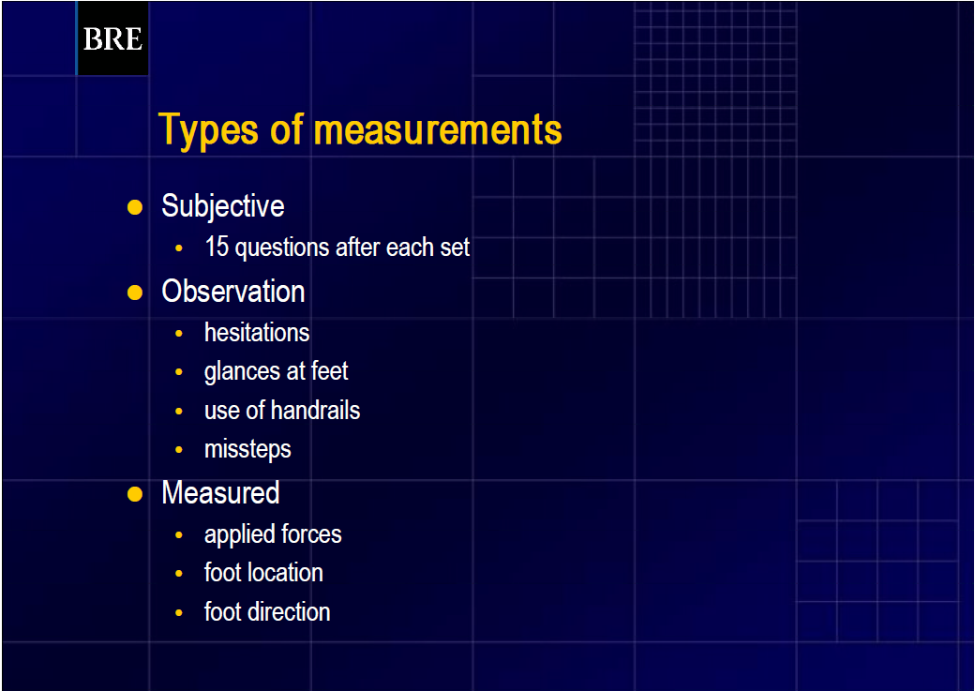
Results were based on
Subjective Responses
Observed motion and behavior
Physical measurement of foot position and applied force to the walking surface

Slide 9
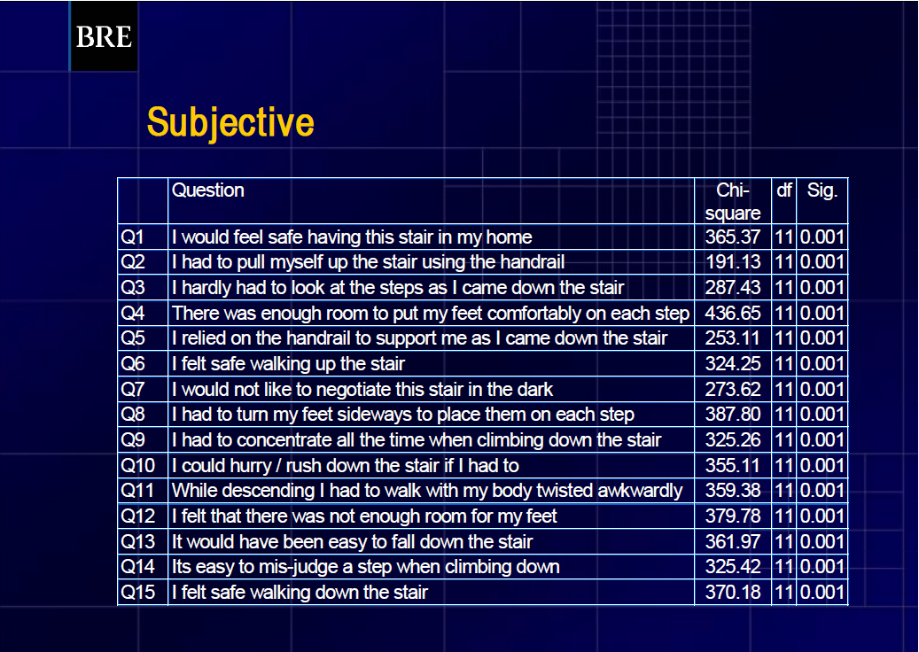
The subject responded to 15 questions following the stairway traverse of each different tread depth.

Slide 10
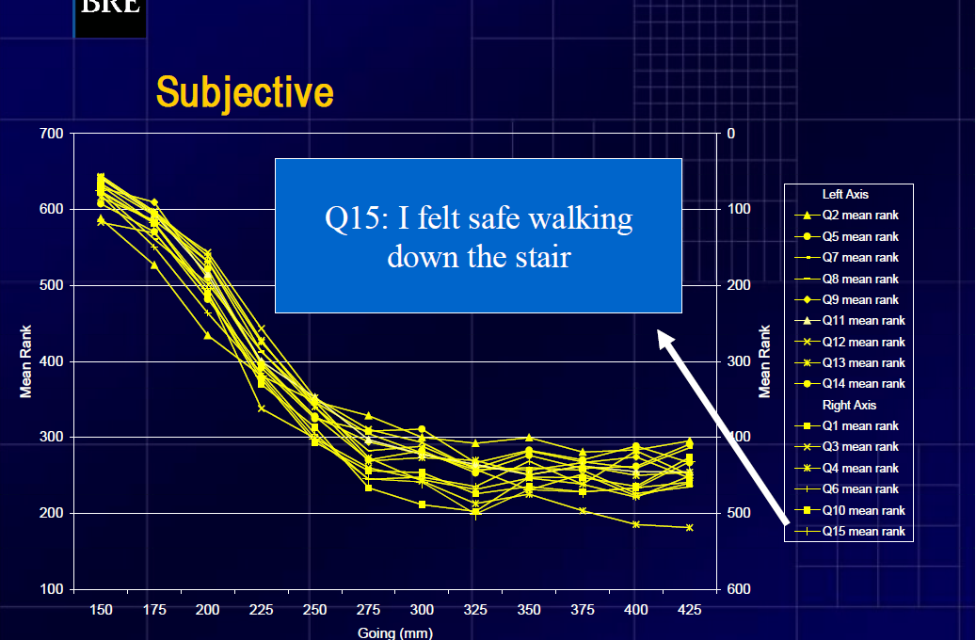
This is a plot of the mean ranking of the subjects’
It is clear that the subjective ranking improves with an increase in tread depth.
This is made apparent by the proponent but does not begin to explain the complete results of this study.

Slide 11
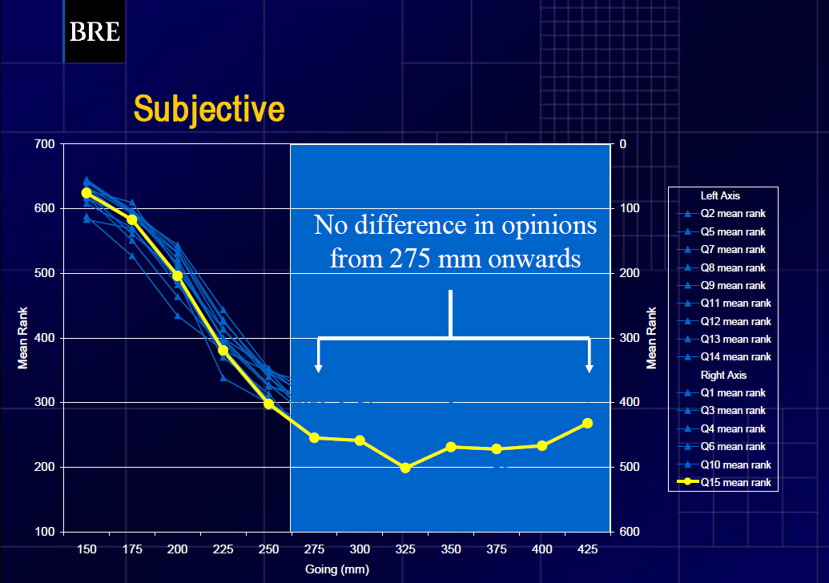
The yellow line is a plot of Q15 “I felt safe walking down the stair”
The variance in the subjective ranking is only 100 out of 700
Subjective results or responses to Q15 shows “NO difference in opinions from 275mm or 10¹³/₁₆ inches tread depth.

Slide 12
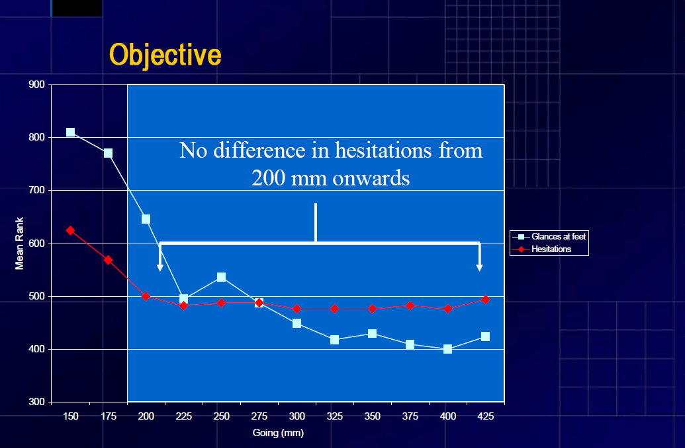
The red line is a plot of hesitations actually observed.
“NO difference in hesitations from 200mm or 7⅞ inches tread depth.

Slide 13
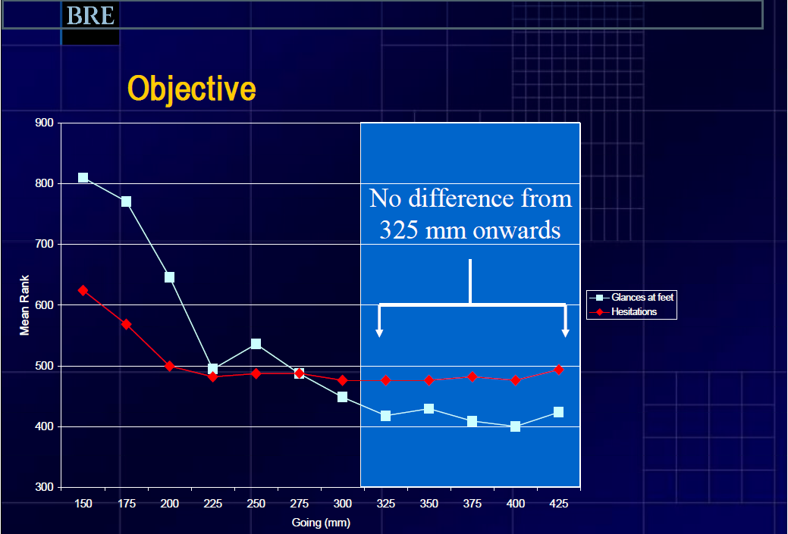
The white line is a plot of glances at feet actually observed.
“NO difference from 325mm or 12¾ inches tread depth.

Slide 14
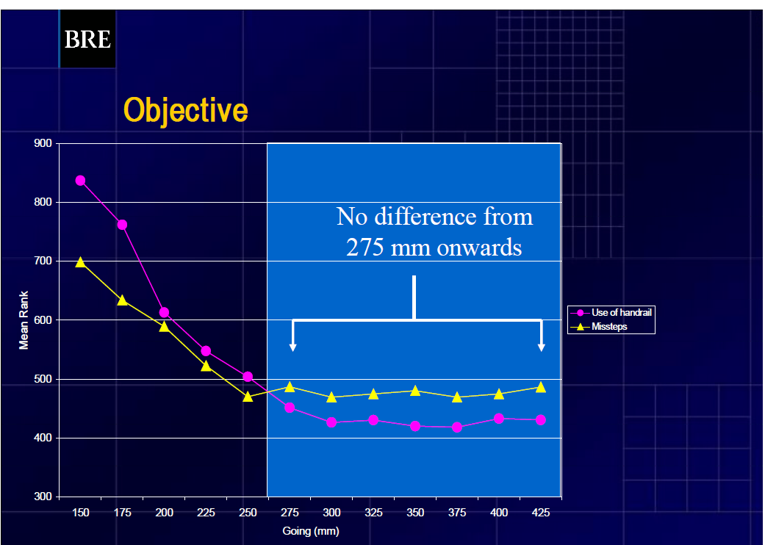
The pink line is a plot of handrail use actually observed.
“NO difference from 275mm or 10¹³/₁₆ inches tread depth onwards.
Note that handrail use increases as tread depth decreases. Good to encourage!

Slide 15
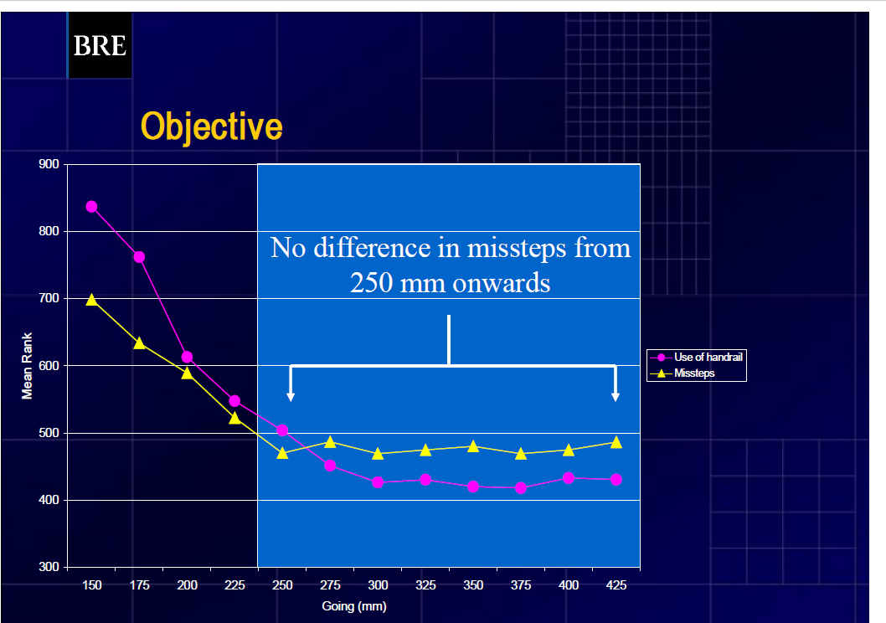
The yellow line in this slide is a plot of missteps actually observed.
“NO difference in from 250mm, 9¹³/₁₆ inches tread depth onwards

Slide 16
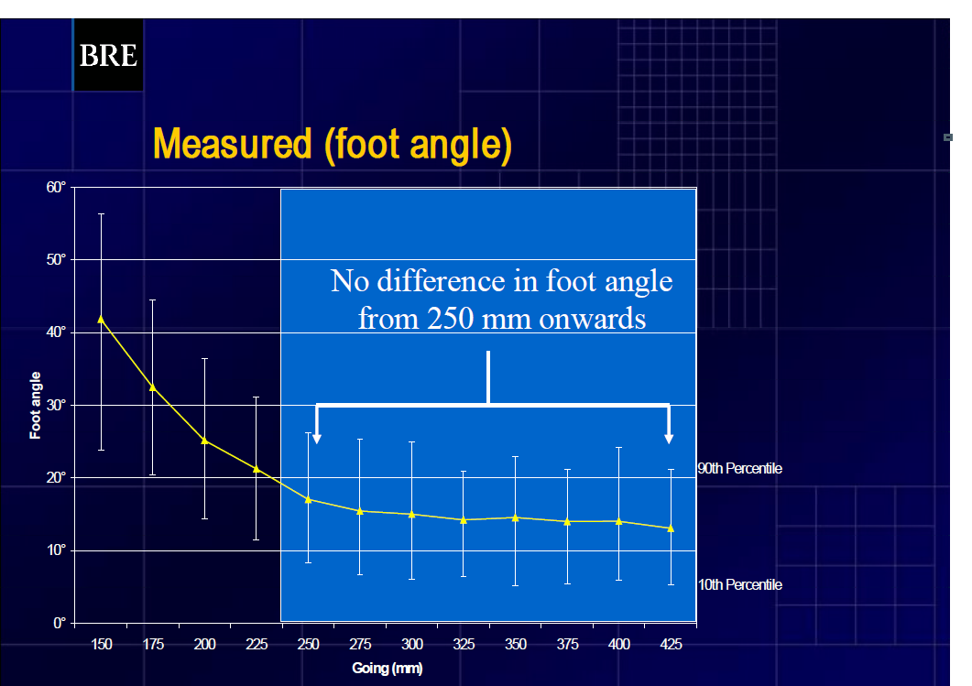
The yellow line in this slide is a plot of foot angle to the leading edge of the tread as measured.
“NO difference in foot angle from 250mm, 9¹³/₁₆ inches tread depth onwards
Crab like walking is not an issue at the current min?

Slide 17
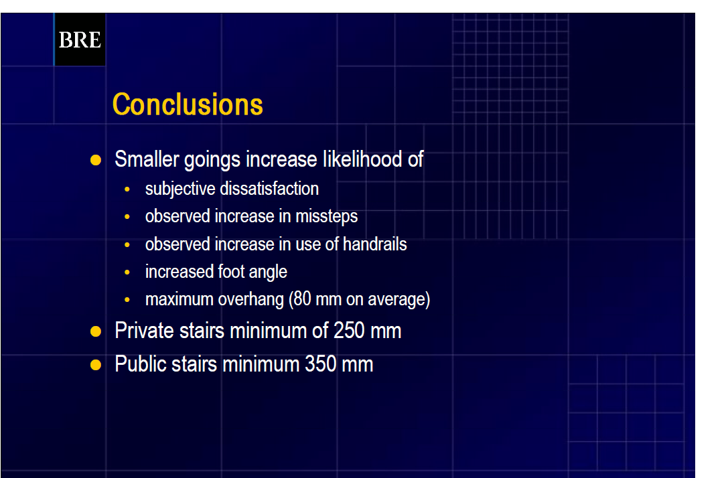
In consideration of all the subjective and objective measurements the conclusion recommends a “double standard” two distinctly different standards for Public and Private /residential stairs.
Residential: 250mm or 9¹³/₁₆ inches …Less than our current minimum tread depth of 10 inches

Slide 18
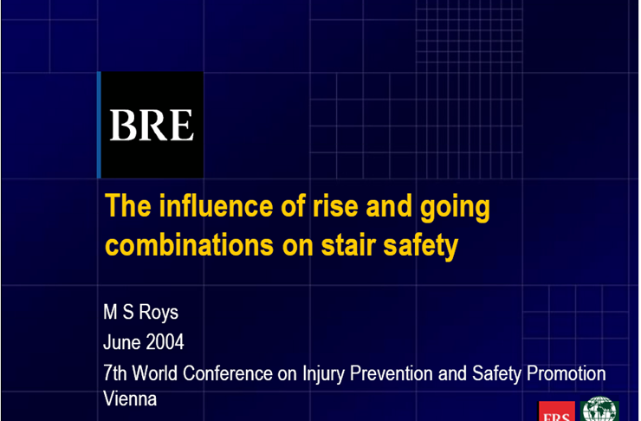
A second study varied the riser height as well as the tread depth and was similar in nature to the prior study with both subjective and objective measures.

Slide 19
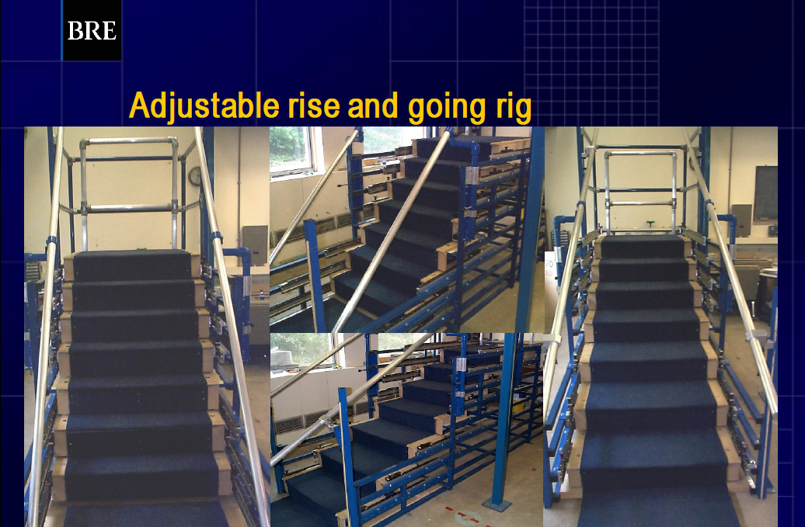

Slide 20
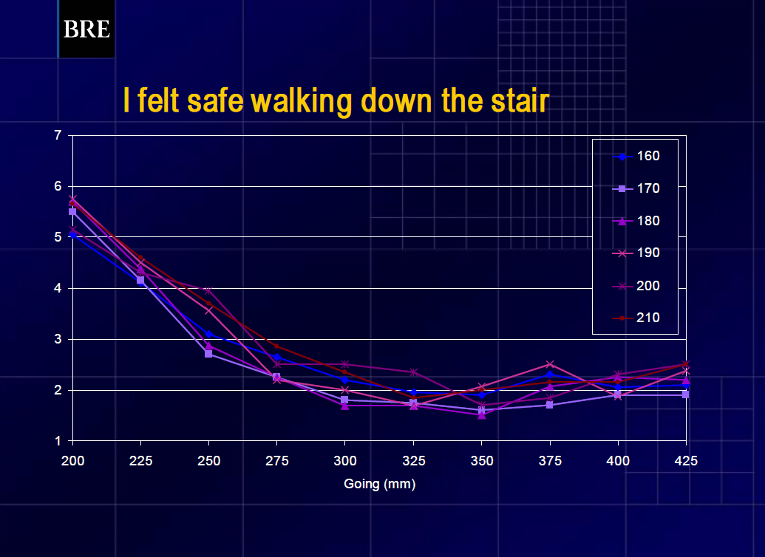
In this graph each line represents the subjects mean response at a different riser height from 160 to 210 mm.

Slide 21
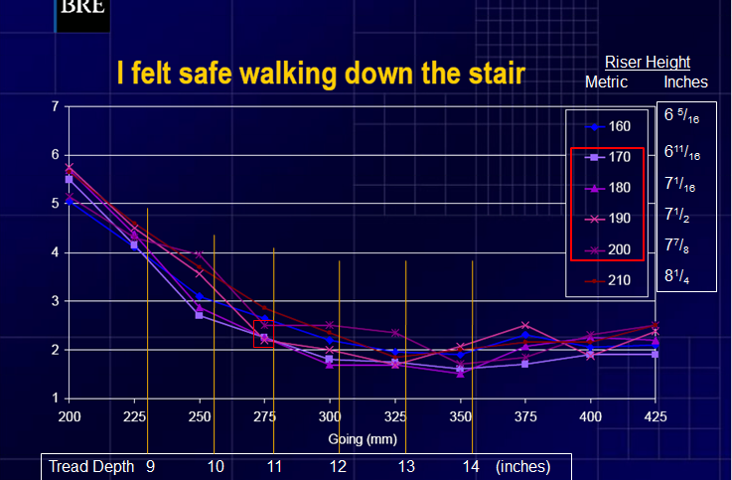
Here I have overlaid the dimensions in inches and emphasis with two red squares.
Note the near convergence of riser height at certain tread depths. Of significance as noted in the red boxes these points would indicate a better under standing of how higher risers might be possible.

Slide 22
The Minimum Standard
The current minimum tread depth complies with the best empirical data from actual tests to date. The maximum riser height needs to be studied more.
It makes no sense to disregard hard facts based on the appellants projections and opinions that lack empirical proof.
The excerpts from the studies shown here clearly show that treads less than 10 inches could be significantly less safe. It is also clear that we already have a reasonable minimum tread depth that is supported by science.
As for NEISS reports of stair accidents they are significant but few if any can be directly linked to the depth of the tread and more importantly although the report data is readily available the appellant only offers a compilation of two unrelated studies of much steeper stairs in the UK to support what after three decades remains opinion.
Established by compromise many years ago due to lack of empirical evidence that would support anything more restrictive these studies as presented in brief here, prove the efficacy of 7¾” x 10” as a minimum standard of safety for certain residential stairways.

